Slide 1
Introduction to
Graph Theory

Slide 2
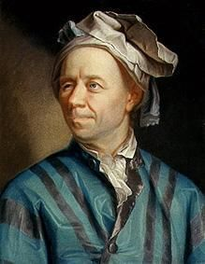
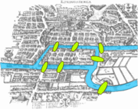
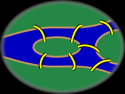
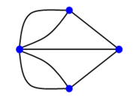
Graph Theory - History
Leonhard Euler's paper on “Seven Bridges of Königsberg” ,
published in 1736.

Slide 3
Famous problems
In 1852 Francis Guthrie posed the “four color problem” which asks if it is possible to color, using only four colors, any map of countries in such a way as to prevent two bordering countries from having the same color.
This problem, which was only solved a century later in 1976 by Kenneth Appel and Wolfgang Haken, can be considered the birth of graph theory.

Slide 4
Basics
Graph theory

Slide 5
What is a Graph?
Informally a graph is a set of vertices joined by a set of lines or arrows.
1
3
1
2
3
2
4
5
6
4
5
6

Slide 6
Definition: Graph
G is an ordered triple G:=(V, E, f)
  V is a set of nodes, points, or vertices.
  E is a set, whose elements are known as edges or lines.
  f is a function
    maps each element of E
    to an unordered pair of vertices in V.

Slide 7
Definitions
Vertex
  Basic Element
  Drawn as a node or a dot.
  Vertex set of G is usually denoted by V(G), or V
Edge
  A set of two elements
  Drawn as a line connecting two vertices, called end vertices, or endpoints.
  The edge set of G is usually denoted by E(G), or E.

Slide 8
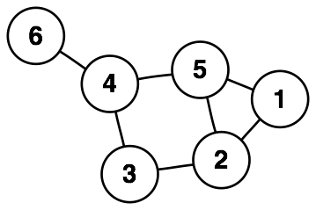
Example
V:={1,2,3,4,5,6}
E:={{1,2},{1,5},{2,3},{2,5},{3,4},{4,5},{4,6}}

Slide 9
Degree
A
B
C
D
E
F
The degree of B is 2.
Number of edges incident on a vertex.

Slide 10
Simple Graphs
Simple graphs are graphs without multiple edges or self-loops.

Slide 11
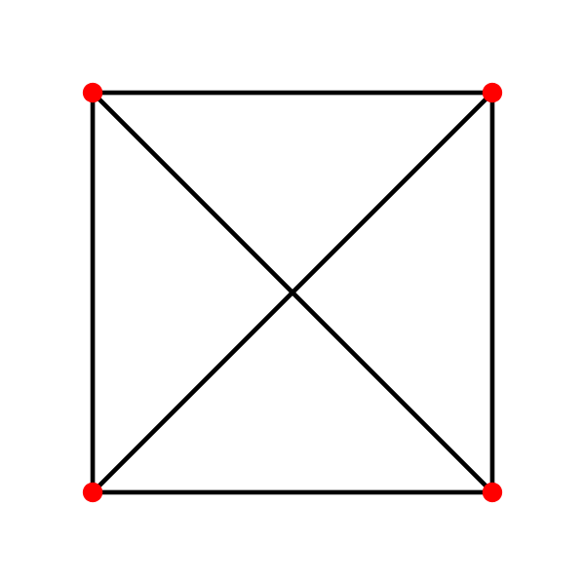

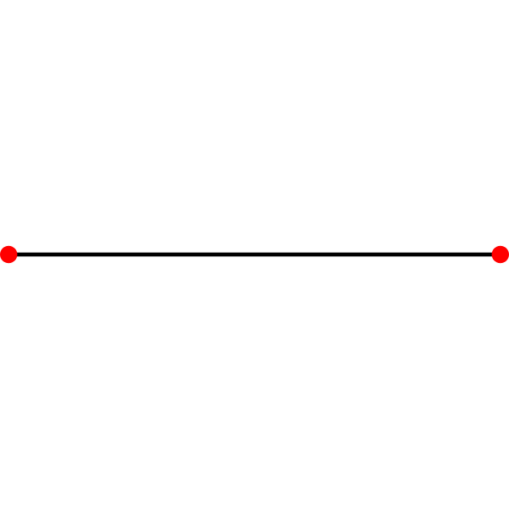
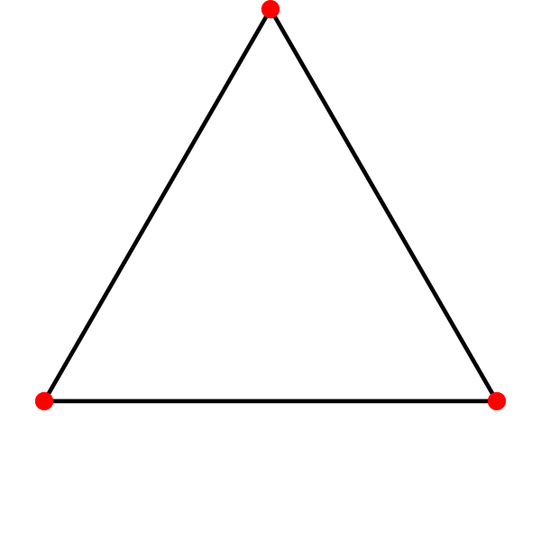
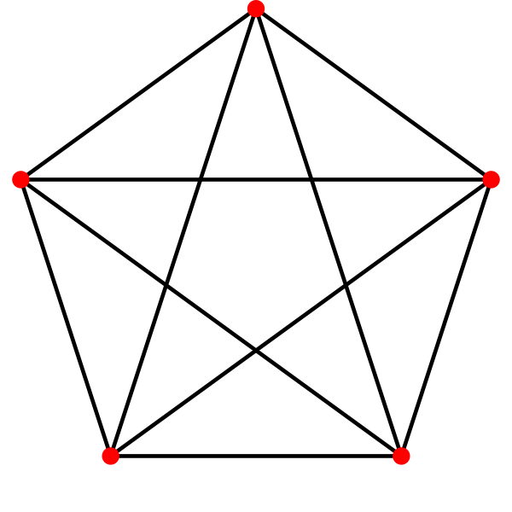
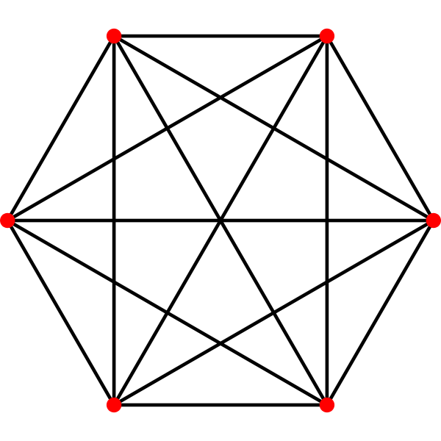
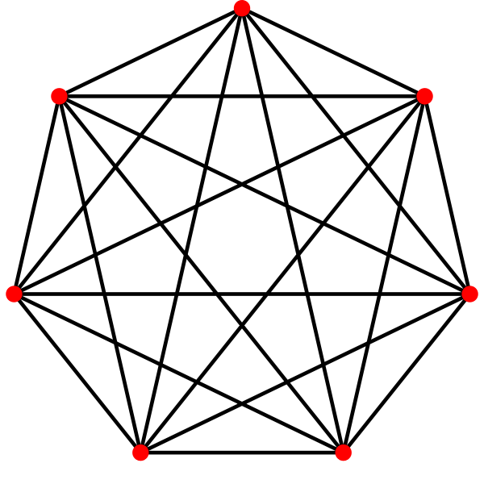
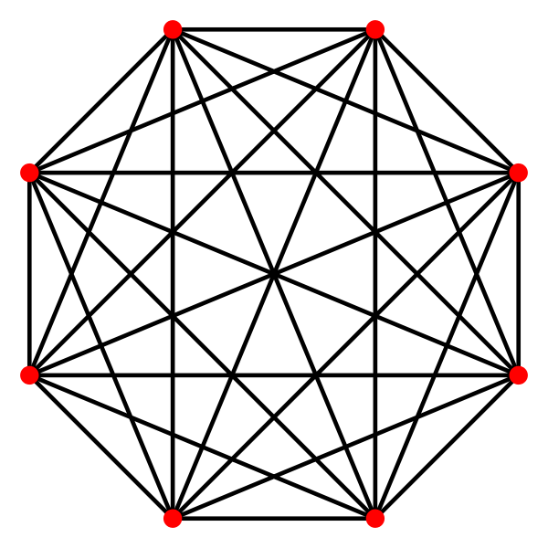
Complete Graph
Denoted K_{n}
Every pair of vertices are adjacent
Has n(n-1) edges

Slide 12
Bipartite graph
V can be partitioned into 2 sets V₁ and V₂
such that (u,v)∈E implies
  either u ∈V₁ and v ∈V₂
  OR v ∈V₁ and u∈V_{2.}

Slide 13
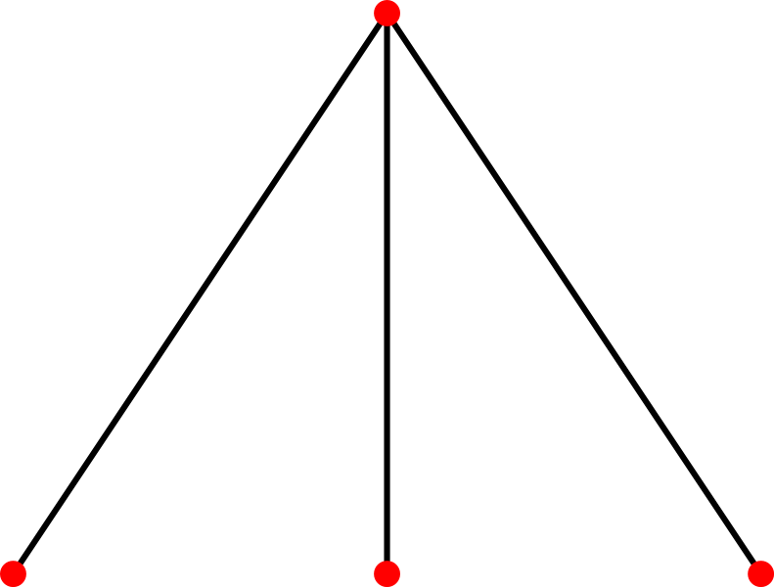
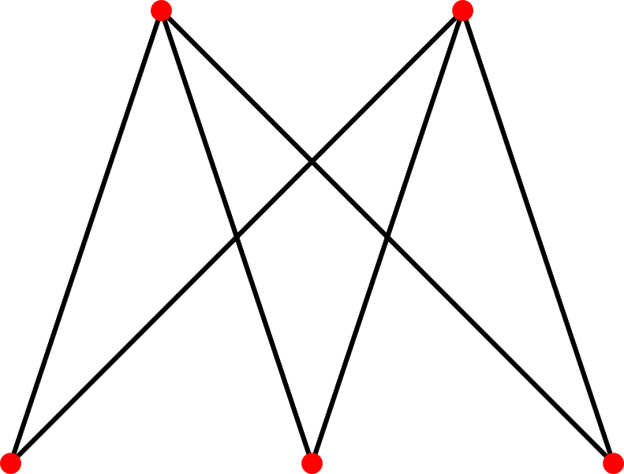
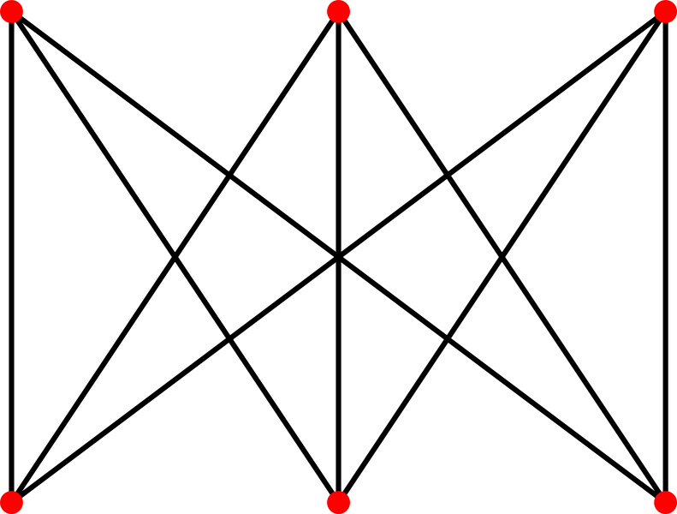
Complete Bipartite Graph
Bipartite Variation of Complete Graph
Every vertex of one set is connected to every other vertex on the other set.

Slide 14
Connectivity
A graph is connected if
  you can get from any vertex to any other by following a sequence of edges (OR)
  any two vertices are connected by a path.
A directed graph is strongly connected if there is a directed path from any vertex to any other vertex.

Slide 15
Cycle
A path from a vertex to itself is called a cycle.
A graph is called cyclic if it contains a cycle;
  otherwise it is called acyclic
1
3
A
B
C
2
Cycle
4
5
6
D
E
F
Cycle
Unreachable

Slide 16
Path
A path is a sequence of vertices such that there is an edge from each vertex to its successor.
A path is simple if each vertex is distinct.
1
3
A
B
C
2
Cycle
4
5
6
D
E
F
Cycle
Unreachable
Simple path from 1 to 5
= [ 1, 2, 4, 5 ]
Our text’s alternates the vertices
and edges.
If there is path p from u to v then we say v is reachable from u via p.

Slide 17
Planar Graph
Can be drawn on a plane such that no two edges intersect
K₄ is the largest complete graph that is planar

Slide 18
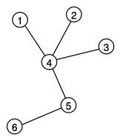
Tree
Connected Acyclic Graph
For any two vertices there exists exactly one path between them.

Slide 19
A weighted graph
It is a graph for which each edge has an associated weight, usually given by a weight function w: E → R.
1.2
2
1
2
3
1
2
3
.2
.5
1.5
5
3
.3
1
4
5
6
4
5
6
.5

Slide 20
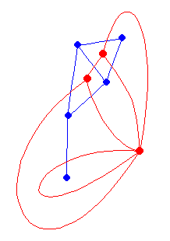
Dual Graph
Faces are considered as vertices
Edges denote face adjacency
Dual of dual is the original graph

Slide 21
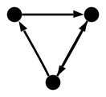
Directed Graph (digraph)
Edges have directions
  An edge is an ordered pair of vertices.

Slide 22
Degree (Directed Graphs)
1
2
4
5
The in degree of 2 is 2 and
the out degree of 2 is 3.
In degree: Number of edges entering
Out degree: Number of edges leaving
Degree = indegree + outdegree

Slide 23
Degree: Simple Facts
If G is a digraph with m edges, then
Σ indeg(v) = Σ outdeg(v) = m = |E |
If G is a graph with m edges, then
Σ deg(v) = 2m = 2 |E |
  Number of Odd degree vertices is even

Slide 24
Subgraph
Vertex and edge sets are subsets of those of G
  a supergraph of a graph G is a graph that contains G as a subgraph.
A graph G contains another graph H if some subgraph of G
  is H or
  is isomorphic to H.
H is a proper subgraph if H!=G

Slide 25
Isomorphism

Slide 26
Isomorphism
Bijection, i.e., a one-to-one mapping:
  f : V(G) -> V(H)
u and v from G are adjacent if and only if f(u) and f(v) are adjacent in H.
If an isomorphism can be constructed between two graphs, then we say those graphs are isomorphic.

Slide 27

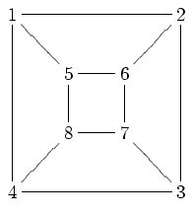
Isomorphism Problem
Determining whether two graphs are isomorphic
Although these graphs look very different, they are isomorphic; one isomorphism between them is
  f(a) = 1 f(b) = 6 f(c) = 8 f(d) = 3
  f(g) = 5 f(h) = 2 f(i) = 4 f(j) = 7

